Slide 1


Image Steganography Tool using android studio and figma- - Stegoanalyzer
-VISHAAL YADAV - G7- CS

Slide 2
Problem Statement :-
Develop a Android application to encode and decode hidden messages within images using security key.

Slide 3
Introduction to Steganography
Definition: Steganography is the practice of concealing a file, message, image, or video within another file, message, image, or video.
Purpose: To transmit information covertly and securely.
Example Use Cases: Secure communication, data protection, watermarking, etc

Slide 4
Key Features
Embed data within an image without visible distortion.
Extract hidden data from an image using a security key.
User-friendly Application for encoding and decoding messages.

Slide 5
Technology Stack Used
FIGMA for UI design.
JAVA language for Android Development.
Integration of JAVA logic and Figma design by Android Studio and finally making a Application.

Slide 6
Encoding Methodology:
Include a security key to the message for added security.
Append a unique delimiter to mark the end of the hidden message.
Convert the message into binary format.
Embed the binary data within the least significant bits (LSBs) of the image pixels.

Slide 7
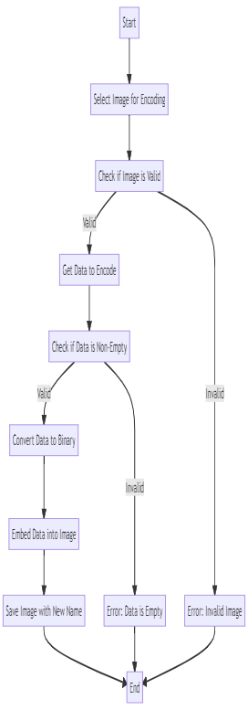
Flowchart of the Encoding Process-
In the encoding process, the goal is to hide a text-based message within an image file without significantly altering the image's visual appearance. The method used is to modify the least significant bits (LSBs) of the image's pixel values with the binary representation of the secret message. Initially, the text message is converted into binary form, along with a unique delimiter to mark the end of the message, and a security key for added protection. The binary data is then embedded into the LSBs of the image pixels, spreading the information across the entire image to minimize visual distortion. This way, the encoded image appears unchanged to the naked eye, while containing the hidden message. Once the data is embedded, the modified image is saved with a new name, ensuring that the original image remains untouched.

Slide 8
Decoding Methodology:
Extract the binary data from the LSBs of the image pixels.
Convert the binary data back to a human-readable format.
Validate the security key to ensure correct decoding.

Slide 9
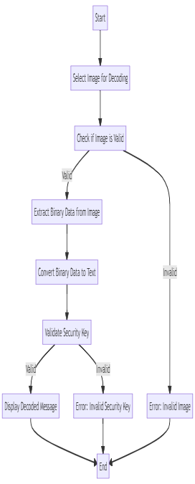
Flowchart of the Decoding Process-
In the decoding process, the objective is to extract the hidden message from an encoded image file. The process starts by reading the LSBs of the image pixels to retrieve the binary data. The binary data is then grouped into bytes and converted back into text. The decoding algorithm looks for the unique delimiter to determine where the hidden message ends. Once the delimiter is found, the extracted security key is compared with the key provided by the user to ensure the correct data is retrieved. If the keys match, the extracted text before the delimiter is displayed as the hidden message. If the key doesn't match or the delimiter is not found, an error message is shown, indicating that the decoding process was unsuccessful or that the security key is incorrect. This dual-validation mechanism ensures that the decoded message is only revealed to authorized users with the correct key.

Slide 10
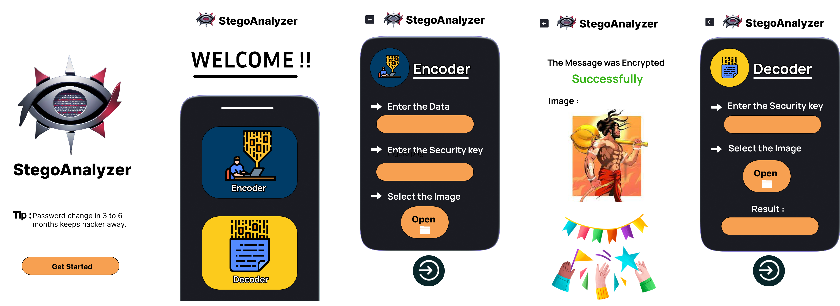
UI of the Application

Slide 11
Integration of logic into Application
Made the application UI using “Figma”.
There are total 5 pages namely, MainPage , ContentPage, EncoderPage, EncoderSuccess, and DecoderPage.
Connected all pages to each other respectively.
After the UI design made the project in the Android Studio and integrated the logic.

Slide 12
Conclusion and Future Work
Conclusion:
The steganography project allows secure transmission of hidden
messages within images, utilizing Java build logic.
Future Work:
Making a basic and a premium user app on basis of inclusion of security key.
Enhanced encryption for more secure data embedding.
Additional features for improved user experience.

